Slide 1













Smart Inventory & Cashflow Optimizer
Inventory optimization platform for retail
AI Statistics
Restock optimization
Escrows through DeFI
Blockchain traceability
"An intelligent system that tracks inventory, optimizes cashflow, reduces losses and ensures total transparency "
Demo presentation

Slide 2













👥Target audience
Stores (Small or Big)
Suppliers and Distributors
Transparency with the supply chains and retailers
Smart inventory administration
Cashflow optimization
Price checks and discounts
AI enhanced consumption predictions
Trustless automated orders
Local Retailers
Inventory syncing between owned stores
Dynamic price strategies
Performance Analytics

Slide 3


















Problem
Retailers face financial and time losses due to three factors :
Overstock
Out-of-stock
Lack of Transparency
Supplier relationship
Money invested
Unavailable products
Bills
Delays
Errors
Blocked money
Missed opportunities
STOP
Product waste causing ecological harm
Annual losses
These problems significantly affect the profit and operational efficiency of stores.

Slide 4














Solution
A complete inventory management system that optimizes operations
Periodic Monitoring
Statistical Analysis of Future Consumption
System that tracks inventory monthly instead of being limited to annual checks.
AI algorithm that analyze history and predict future consumption. Anticipates seasonal events by analyzing historical sales data. Helping retailers stay prepared, avoid stockouts, and maximize profits.
Automated restock
Monitors inventory levels in real time. Ensures that popular products are always available. Place orders directly, streamlining the entire supply chain process and saving both time and resources
Intelligent Purchase Planning
Demand and suggests the best time to buy to minimize cost. The calendar feature helps schedule purchases strategically. Optimal days to place orders.
Blockchain Traceability
All transactions are recorded in blockchain, providing complete transparency and auditability.

Slide 5



















🧩 Sui integration
Object-Centric model
Quick enabling
Smart Contracts
Wallet connection
Stores, shelves is stores, product items becomes objects on chain with their own properties.
Under 1 second for stock updates ensuring real-time operation.
All actions are recorded immutably on the blockchain. Faster operations with less manual intervention
Sign transactions securely for actions like creating store, purchasing items, creating orders and escrows
Perfect for supply chain management
Move Security
. Preventing duplicate inventory and fraudulent manipulations, ensuring data integrity

Slide 6












🔒 Why blockchain anti-database argument
It is not just “an inventory on the blockchain.” It is justified for several reasons:
Benefit
Blockchain
Full traceability
prices and discounts -> the supplier cannot "lie" to you later
Verifiable prices and discounts
It can be proved to the supplier when, how much and at what price you bought
Audit and compliance
Audit and compliance - easy and transparent
.

Slide 7









🤖 AI Enhanced Decision Making
What is my next action?
When should I buy?
Looks over the suppliers discounts and makes a decision whether you should buy now, or hold and buy at a later date for a higher profit
What is the day that I’m guaranteed to turn in the most profit based on the clients spending habits and suppliers price changes?
Expected profit
Shows expected profit from transactions if following the proposed decisions

Slide 8















DeFI Solution using Escrows
Money added in Escrow accounts
Payment processed
SupplyChain
Delivery
Stores order items from the suppliers
The money will be added to an escrow account for holdings until the delivery arrives
Delivery arrives and the store checks the details
Payments will be processed from the store to the supplier
Benefits
Automated Trustless Payments
Cashflow Optimization
Transparency & Auditability
SIAO - Smart Inventory Auto-Replenish & Cashflow Optimizer

Slide 9








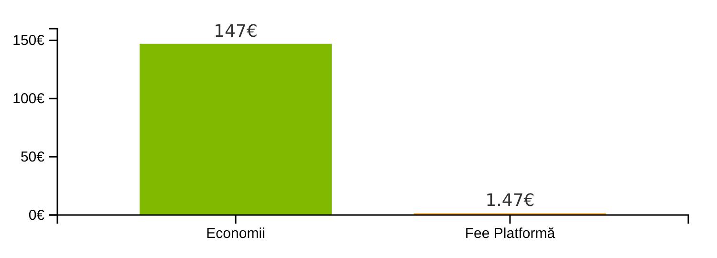


Pricing & Revenue Model
Weekly Sample Report
Savings achieved by avoiding overstocking
Reducing storage costs
You saved €147 by avoiding overstocking.
Cash flow optimization
Platform Fee:
1.47€
Savings vs Fee Relationship
Fee calculation
Calculation model: The platform takes 1% of the savings generated for:
Ensuring the quality of services
Supporting platform development

Slide 10


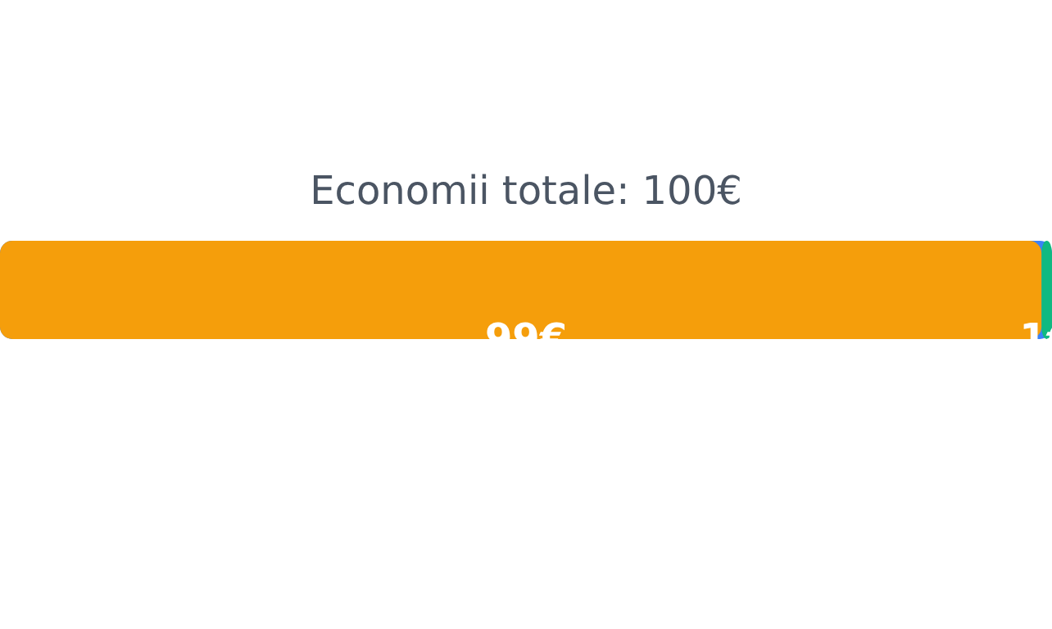



💰 Monetization Model - Fee on Savings
Benefits
You only pay when you save
How the model works
There are no hidden costs
Total savings
99%
1%
Our FEE (1%)
Net for client

Slide 11
















💰 Abonament și Fee-uri Automate
Monthly payment
Fees on Savings
9€/month
1%/month
Access to Smart Inventory and AI
We guarantee that you will turn a profit
AI enhanced for your profits
Fee is taken quarterly from the profits you’ve made using our application
Smart tracking of inventory
Buying suggestions for supplychains
Ideal for retailers that want to optimize their profits from supplier orders
Fee is taken only on the profit obtained from using our solution

Slide 12












🚀 The future
Expansion into new sectors
Expansion into new sectors. Public services - medical inventory in hospitals
Improving AI algorithms
Continuous development of artificial intelligence algorithms for more accurate predictions and advanced predictive analytics.
Stay aligned with the latest developments in blockchain. Create automated notifications.
Roadmap de dezvoltare
Functionality extensions
AI improvements
Optimized Blockchain
Complete ecosystem
First quarter 2026
Second quarter 2026
2025-2026
2026+

Slide 13


